Slide 1
My Azure startup odyssey with .NET MAUI & Blazor
From Backend to Full-Stack
Notes:
Presentation Structure
Introduction
Personal Background: Briefly introduce yourself, emphasizing your transition from a backend developer to a full-stack developer.
Startup Overview: Provide an overview of your startup, including its mission and the product you developed.
Development Journey
Challenges Faced: Discuss the initial challenges you encountered, such as the need to adapt to full-stack development and the specific requirements of your project.
Choice of Technologies: Explain why you chose Microsoft technologies, focusing on Blazor and .NET MAUI.
Building with Blazor and .NET MAUI
Component Sharing: Illustrate how Blazor and .NET MAUI allowed for efficient sharing of components across different parts of your application.
MudBlazor Library: Highlight the benefits of using MudBlazor, including specific features that added value to your development process.
Deployment to App Stores: Talk about your experience deploying the apps to Google and Apple app stores, noting any challenges and how you overcame them.
Leveraging Azure B2C
Authentication & Security: Discuss the role of Azure B2C in your application, focusing on authentication and security.
Customization and Custom Policies: Detail the customization work you did, particularly with custom policies in Azure B2C.
API Strategy
API Development and Management: Share insights into your API strategy, including how it supports your application's functionality and user experience.
Integrating External Services
Stripe: Explain how Stripe facilitated payment processing in your app.
SendGrid: Discuss how you used SendGrid for email services and its impact on your product.
Support and Resources
Microsoft Startup Founder Hub: Share your experience with the Microsoft Startup Founder Hub and how it supported your startup journey.
Conclusion
Key Takeaways: Summarize the key points of your presentation.
Future Directions: Briefly mention any future plans or developments for your startup.
Q&A Session: Open the floor for questions and further discussion.
Visual Aids
Use slides to visually represent key concepts, such as architecture diagrams, code snippets, and screenshots of your application.
Include charts or graphs to illustrate performance improvements or user engagement metrics.
Engagement Tips
Share real-world examples or anecdotes from your development experience to make the presentation relatable.
Encourage audience interaction through Q&A or quick polls, especially when discussing more technical aspects.
This structure should help you create a comprehensive and engaging presentation that highlights your journey, the technologies you used, and the impact they had on your startup's success.

Slide 2

readme.md
Belgium
Microsoft Azure MVP (10 years)
Advisor and investor in cloud-startups
Co-Founder & Tech lead at Sfinx (access control)
Focus on Data & A.I. and Serverless
Passion for cycling & traveling

Slide 3

How did I end up here?
2001: Started at a dev shop – learned BizTalk
2002: Joined an industry company – mastered BizTalk
Invested and joined as shareholder at Codit 2007
CTO – focused on Backend & Cloud integration 2008
Codit acquired by Proximus, stock listed company 2018
2004: Joined "1 person company" Codit
Left Codit, and started working with startups 2021
Azure product de velopment 2010
2022: Tech advisor at uman.ai
2022: Co-founder, tech lead, dev, app dev, advisor at Sfinx
Backend
Full-stack

Slide 4


What I’m working on

Slide 5



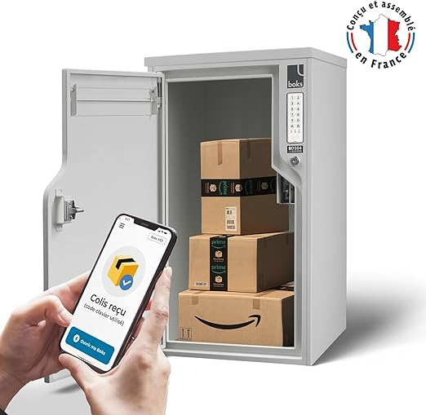

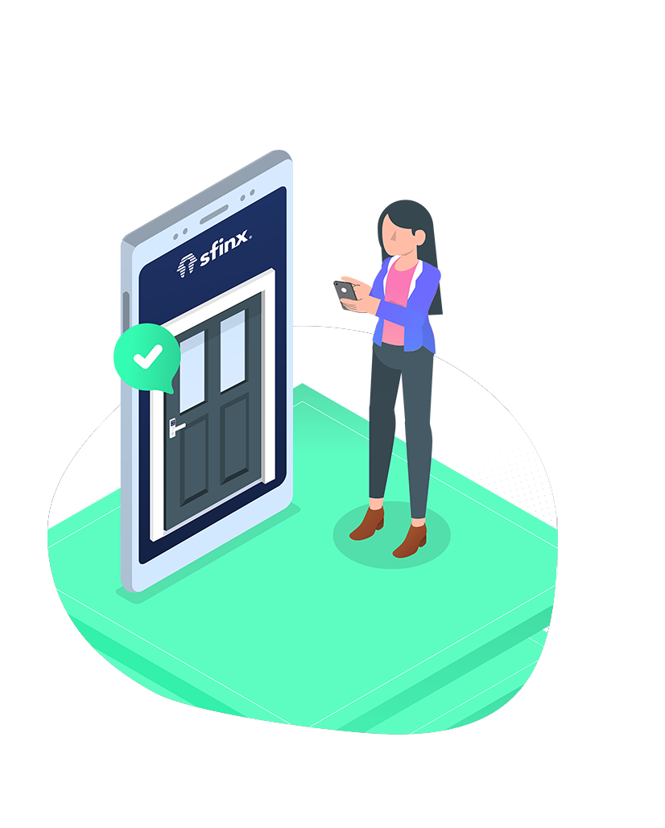

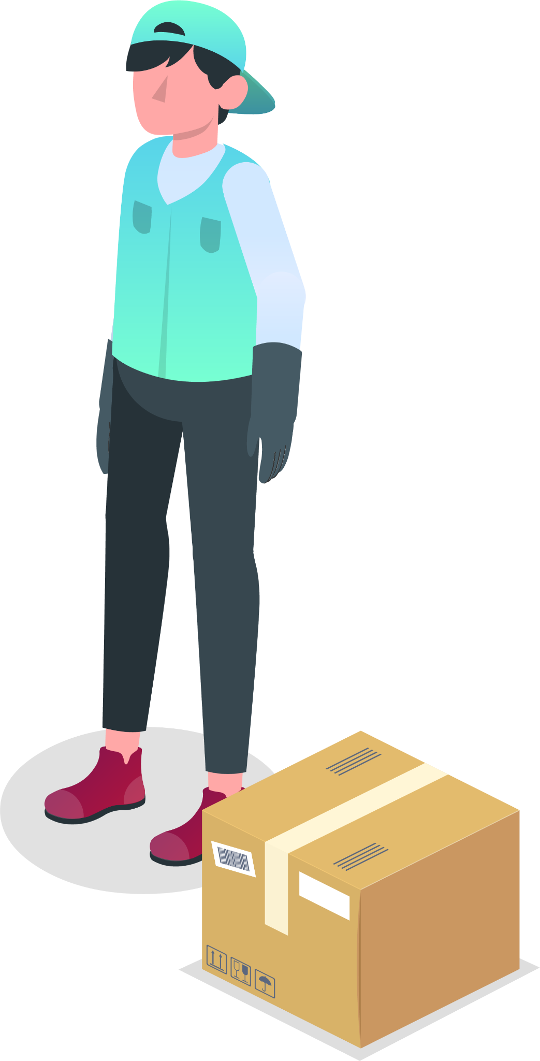


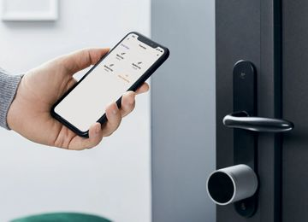




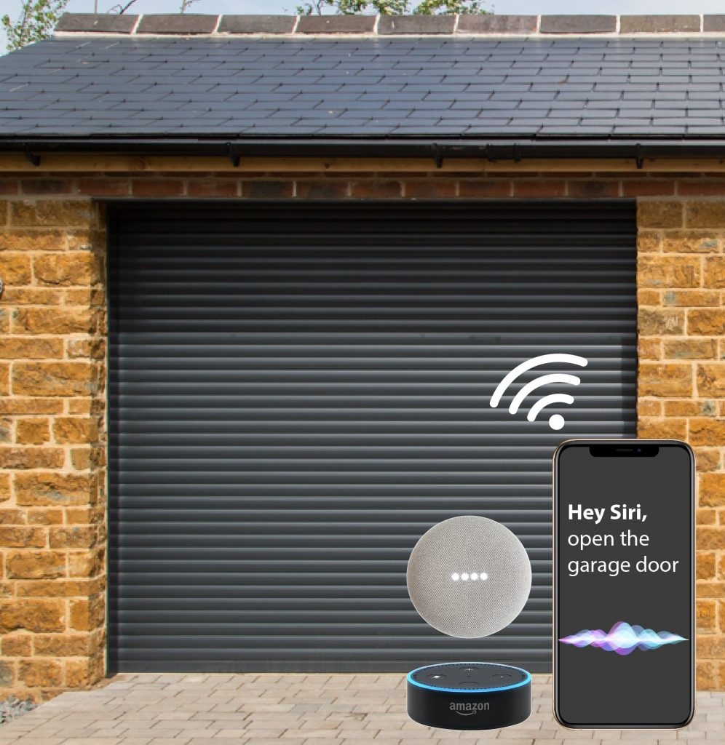

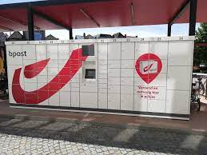
Physical access management
...
Service providers
Home owners
Sfinx customers
Sfinx users

Slide 6


Our team
CEO
Business lead
Marketing Manager
V.P. of Sales
Administrative Assistent
CFO
Legal advisor
Web master
H.R. & Recruitment
CTO
Technical lead
Software Architect
Test engineer
Backend & API developer
DevOps guy
Product manager
App Developer
UX Designer
Business team
Tech team
Mathijs
Sam

Slide 7

Make it work,
Make it right,
Make it fast
- Kent Beck -

Slide 8
The healthy use of technical debt
Technical debt
Tech investment
Major release
Healthy velocity
Features & scale
Product clean-up
Over-engineering
Time
Notes:
Joshua Levy on Twitter: "So how would you explain tech debt to junior engineers—or anyone who cares about engineers? Here's my attempt, in one sketch. Good software engineering usually boils down to tough trade-offs... 🧵 https://t.co/1TfcvzFOpB" / Twitter

Slide 9










Architecture
My bread & butter
(iOS, Android, Web Portal)
Async
Commands
Background
Workers
Azure Entra ID
API Management
Backend API
Lock Adapters
Locks
OpenAPI integration
Consumers
An open extensible platform
Secure
Key Vault
Notes:
Build up of architecture
- start with back end & data
- continue with API
- set up web portal >> Blazor
- set up app >> MAUI
- auth > B2C

Slide 10
But what about this?
Notes:
Build up of architecture
- start with back end & data
- continue with API
- set up web portal >> Blazor
- set up app >> MAUI
- auth > B2C

Slide 11
But what about this?
End user portal
Organization portal
Web shop
Administration portal
Common logic
Same styling
Lowest barrier to entry
End user app
Service provider app
Notes:
Build up of architecture
- start with back end & data
- continue with API
- set up web portal >> Blazor
- set up app >> MAUI
- auth > B2C

Slide 12

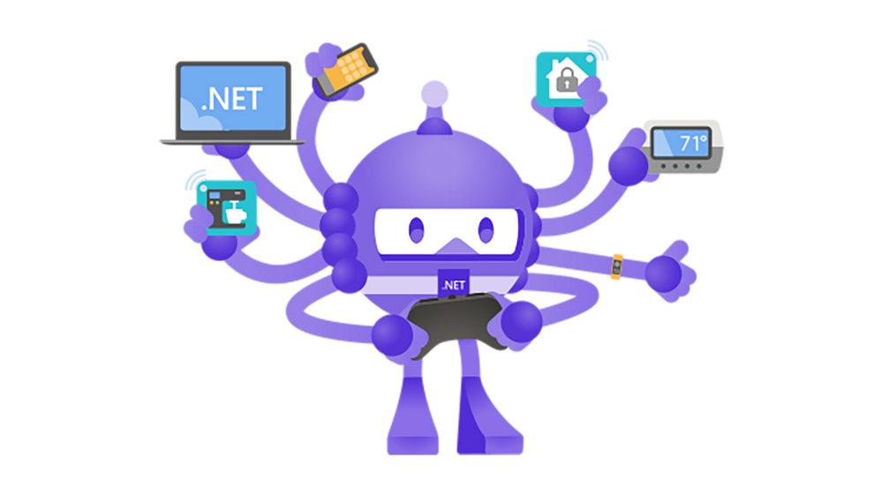
.NET Blazor & MAUI to the rescue
Common logic
Same styling
Lowest barrier to entry
.NET MAUI
Notes:
Build up of architecture
- start with back end & data
- continue with API
- set up web portal >> Blazor
- set up app >> MAUI
- auth > B2C

Slide 13
Other services
Payments
Email merge

Slide 14
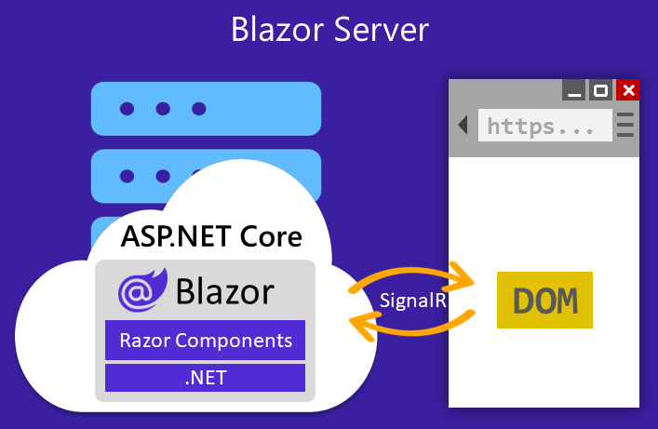
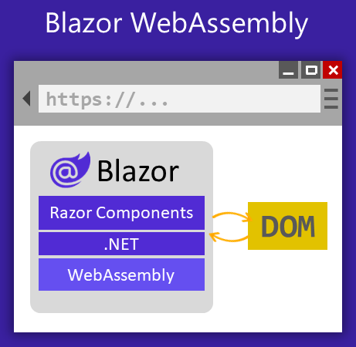

ASP.NET Core Blazor
UI handling : SignalR over Websockets
Circuits per browser screen (server state)
Smaller download , faster loading
Higher latency
Runs client side in WebAssembly .NET runtime
Progressive Web App (PWA) are possible
Heavier download , faster loading
Lower latency, runs on the client
Notes:
https://learn.microsoft.com/en-us/aspnet/core/blazor/hosting-models?view=aspnetcore-8.0

Slide 15
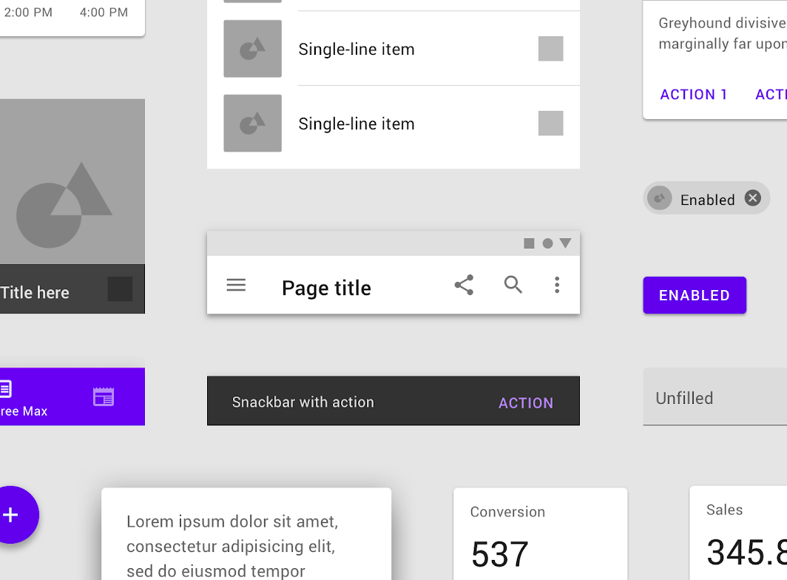
MudBlazor : a free library
Based on Material Design
Well-documented
Easy to install (nuget + few steps)
Open source

Slide 16
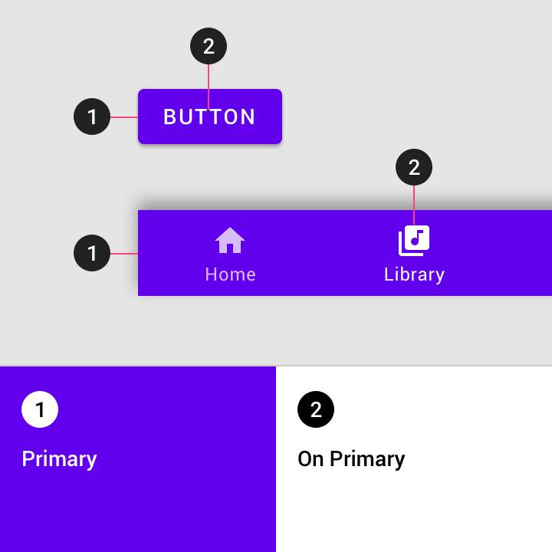
Themes
Define your color palette
Define your fonts & typography

Slide 17
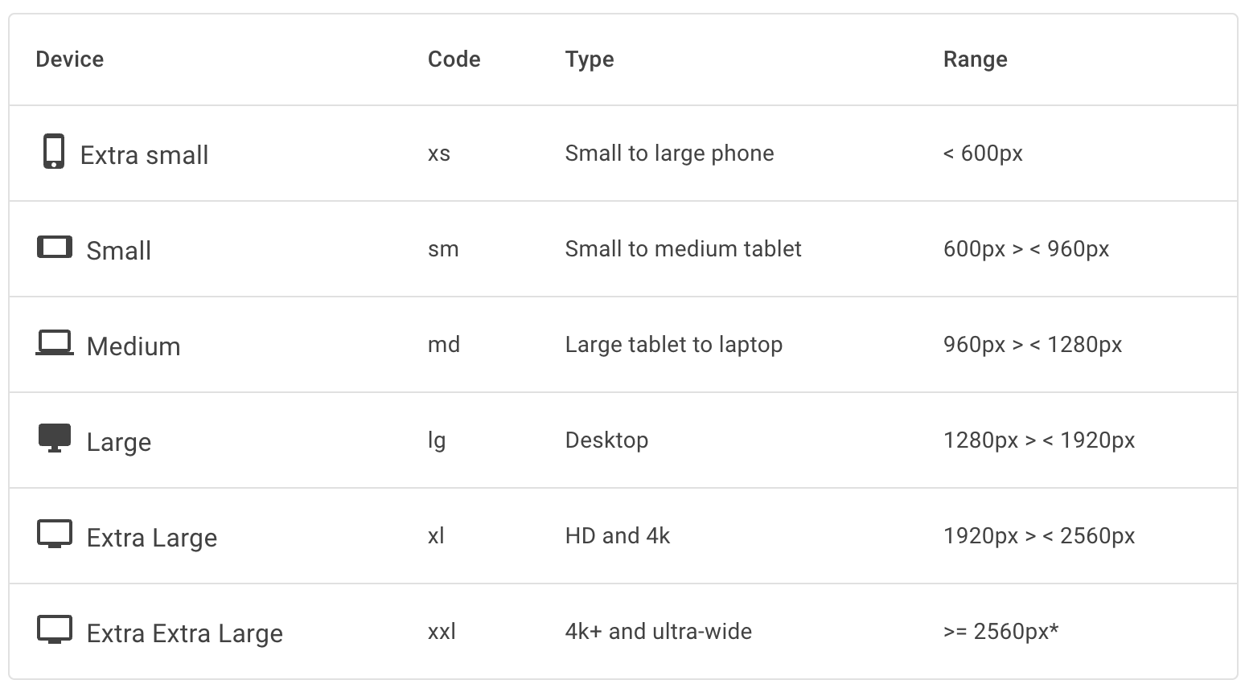
The grid
Responsive UI
MudGrid
Grid layout
MudHidden
Hide specific content, based on screen size

Slide 18

Demo
Building a Blazor website
Mudblazor : responsive grid & customized palette / theme

Slide 19
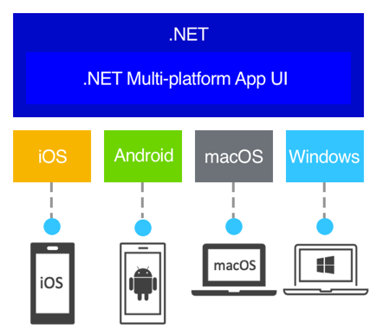
.NET MAUI
Develop apps that can run on Android, iOS, macOS, and Windows from a single shared code-base
Evolution of Xamarin.Forms
Notes:
https://learn.microsoft.com/en-us/dotnet/maui/what-is-maui?view=net-maui-8.0

Slide 20
Getting started
It is a lot of pain, if you are new to this
Install xcode for iOS
Install Android studio
Publishing to the iOS app store
Register (and pay) for an iOS developer account
Generate images (screenshots) for all screen sizes
Indicate privacy policy, terms&conditions, provide test account, etc
Notes:
https://learn.microsoft.com/en-us/dotnet/maui/what-is-maui?view=net-maui-8.0

Slide 21
Do I have to learn XAML now?
Up to you!
There is support for Blazor (also Hybrid!)
Reuse components from Web in App
Your own components
Existing MudBlazor components !

Slide 22
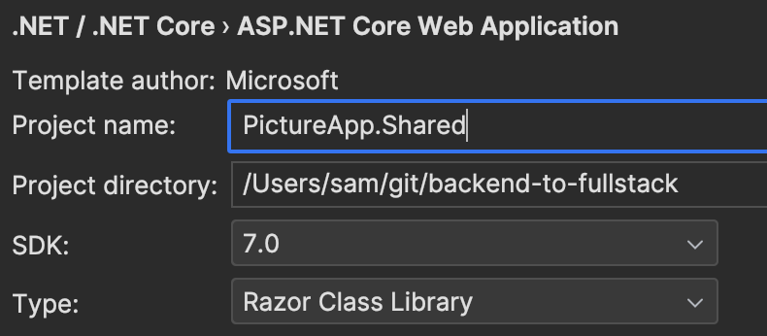
Shared code between web & app
Create a Razor Class Library (RCL) project
Include shared pages in routing
Update App.razor: <Router AppAssembly="@typeof(App).Assembly" AdditionalAssemblies="new []{typeof(About).Assembly}">
Update links & refs to “_content/sharedlibraryname/”
<link rel="stylesheet" href="_content/PictureApp.Shared/css/bootstrap/bootstrap.min.css"/>
<MudImage Src="_content/PictureApp.Shared/images/fullstack-logo.png"></MudImage>
Notes:
Sharing images between projects : visual studio - ASP.Net Core: Use Shared Project to share static assets (css / js) between many projects - Stack Overflow

Slide 23
Troubleshoot unhandled exceptions
Enable web developer tools
#if DEBUG builder.Services.AddBlazorWebViewDeveloperTools(); #endif
Use browser developer tools
edge://inspect/#devices
chrome://inspect/#devices
Notes:
MAUI blazor an unhandled error has occurred - Stack Overflow

Slide 24

Demo
Building a .NET MAUI app
Reusing components from Blazor Web

Slide 25
Approach to testing
Unit tests (in CI/CD & dev environment)
Integration tests (focused on API functionality & scenario driven)
Leveraging SpecFlow as design language/syntax
Front end tests (focusing on browser behavior, storage, etc)
Leveraging Cypress.io
Notes:
npx cypress open
https://blog.apify.com/how-to-record-test-cypress-recorder-extension/#:~:text=In%20the%20Chrome%20DevTools%20Panel,in%20the%20drop%2Ddown%20list.&text=In%20the%20Cypress%20Recorder%20panel,recording%20your%20actions%20in%20Chrome.

Slide 26
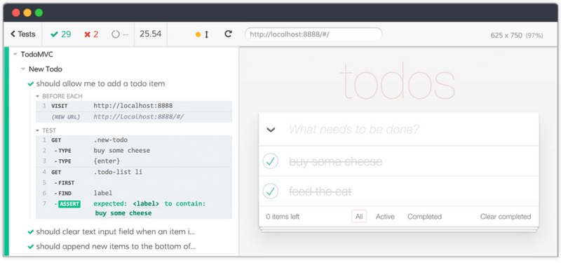
Testing with Cypress.io
Notes:
npx cypress open
https://blog.apify.com/how-to-record-test-cypress-recorder-extension/#:~:text=In%20the%20Chrome%20DevTools%20Panel,in%20the%20drop%2Ddown%20list.&text=In%20the%20Cypress%20Recorder%20panel,recording%20your%20actions%20in%20Chrome.

Slide 27

Demo
Record tests
Generating & running front end tests with Cypress.io

Slide 28


Thank you let’s connect
twitter.com/SamVanhoutte
github.com/SamVanhoutte

